Slide 1
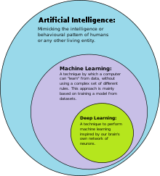
deep learning
Deep learning is a branch of machine learning based on a set of algorithms that attempt to model high-level abstractions in data.

